Slide 1

Sperner’s lemma
Callyn Villanueva
1257192

Slide 2
outline
1. Introduction to Sperner’s Lemma
1.1 Abstract
1.2 Background
2. Fundamental Mathematics
2.1 Proof of Sperner’s Lemma
2.2 Propositional Proof
3. Analyzation
3.1 One Dimensional Case
4. Application of Sperner’s Lemma
5. Conclusion
6. References

Slide 3



1. Introduction to Sperner’s lemma
1.1 Abstract
Triangle = {V1, V2, V3}
Each vertex is colored with one of n+1 colors (3 in the 2-dimensional case)
Every Sperner coloring of a triangulation contains at least 1 multicolored triangle in the subdivision

Slide 4
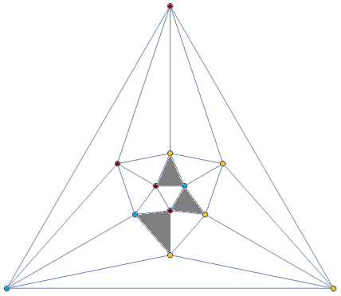
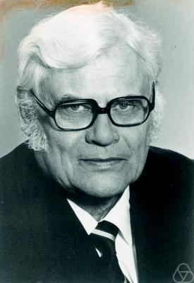
1.2 Background
Fig. 1 Brouwer's fixed point theorem
Fig 2. Emanuel Sperner

Slide 5
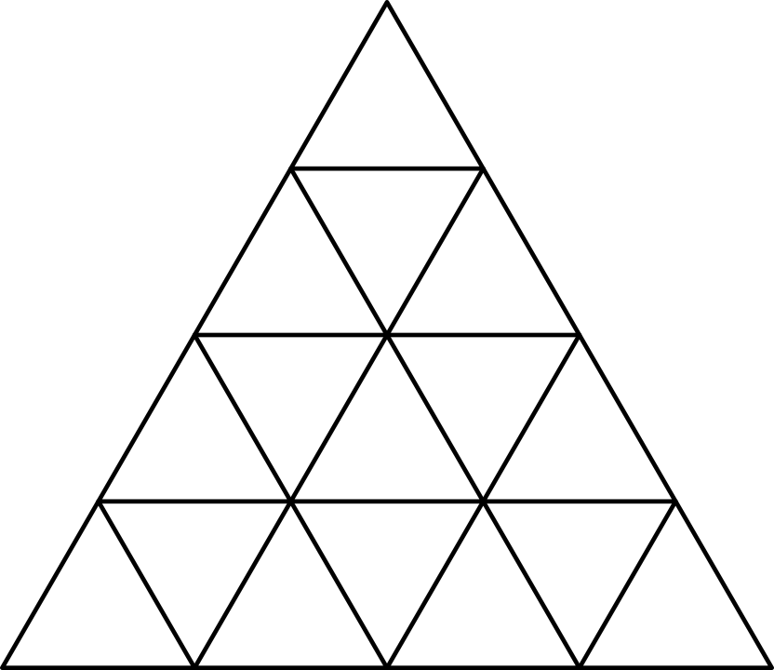

2. Fundamental Mathematics
2.1 Proof of Sperner’s Lemma
The classic Path-following Argument
Edges are “doors”
Sub-triangles are “rooms”
2n + 1 of R-G edges
2n + 1 of G-B edges
2n + 1 of R-B edges

Slide 6
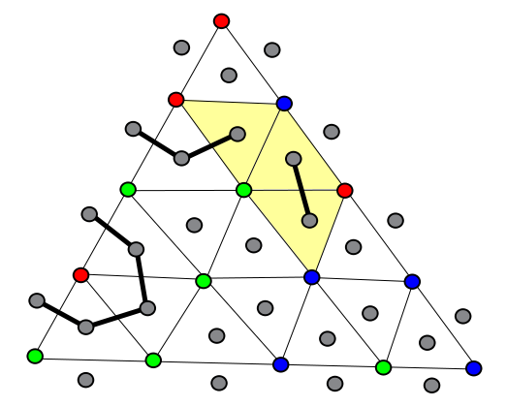
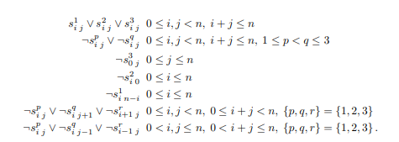

2.2 Propositional Proof
Encoding Sperner’s Lemma as Propositional Logic
$$s_{i}^{p}for o≤ⅈ,j≤n,j+j≤n,P∈\left[1,2,3\right]$$
Fig. 3 Propositional Proof

Slide 7

3. Analyzation
3.1 One Dimensional Case of Sperner’s Lemma
K-Vertices are either 0 or 1, interval is [0,k-1]
$σ_{i}=\left[ⅈ,ⅈ+1\right]⊂\left[0,k−1\right]$
Proof. For each σi, let F(σi) be the number of endpoints of σi which are labelled
by zero. F takes the values 0,1 and 2. Then we calculate the values, $Σ_{i}F\left(σ_{i}\right)$
0 0 1 0 1 1 0 1 1

Slide 8

4. Application
Sperner’s Lemma on Brouwers Point Theorem
Unit simplex S, continuous f: S → S. Then f has a fixed point: f(s) = s for some s ∈S.
Therefore:
THE LIMIT IS THE FIXED POINT

Slide 9
5. Conclusion

Slide 10
6. references
[1] Das, S., & Szabó, T. (2017, August). Sperner's Lemma and its applications. Extremal Combinatorics, FU Berlin, WiSe 2017-18 Retrieved from http://discretemath.imp.fu-berlin.de/DMII-2019-20/Sperner.pdf
[2] Chekuri, C. (2008). CS 573: Algorithmic Game Theory. Retrieved from chekuri.cs.illinois.edu/teaching/spring2008/Lectures/scribed/Notes6.pdf
[3] Dantchev, S.S. (2006). On the Complexity of the Sperner Lemma. CiE.
[4] Huang, J. (2004). On The Sperner Lemma And Its Applications
[5] Fox, J. (n.d.). Lecture 3: Sperner’s lemma and Brouwer’s theorem. Retrieved frommath.mit.edu/~fox/MAT307-lecture03.pdf
[6] Fig.1 cp4space.wordpress.com/2013/11/30/brouwers-fixed-point-theorem
[7] Fig. 2 opc.mfo.de/detail?photo_id=3961

